Slide 1
POWERPOINT
@ FIRECREST

Slide 2
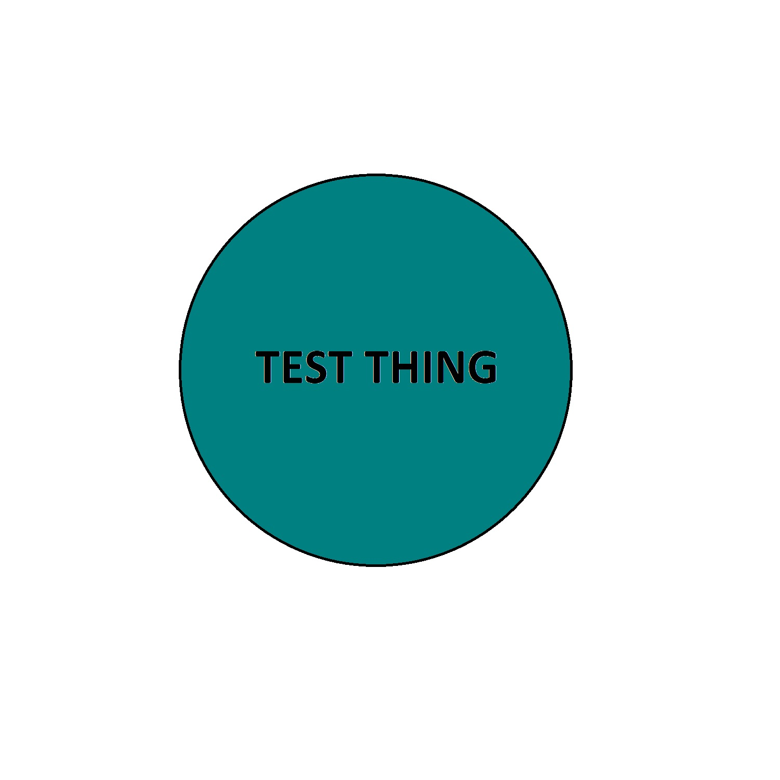
What is?
Yes
Several
At least one
Blue

Slide 3
But does it?
Maybe
Up for debate
The science is in denial

Slide 4
How can we?
Carefully
Briefly
Without crying

Slide 5
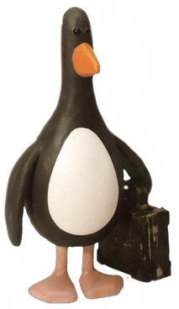
Should we?
Moral conundrums
What would happen if we combined the trolley problem and the traveling salesman problem?
Is this penguin illegal?

